Slide 1
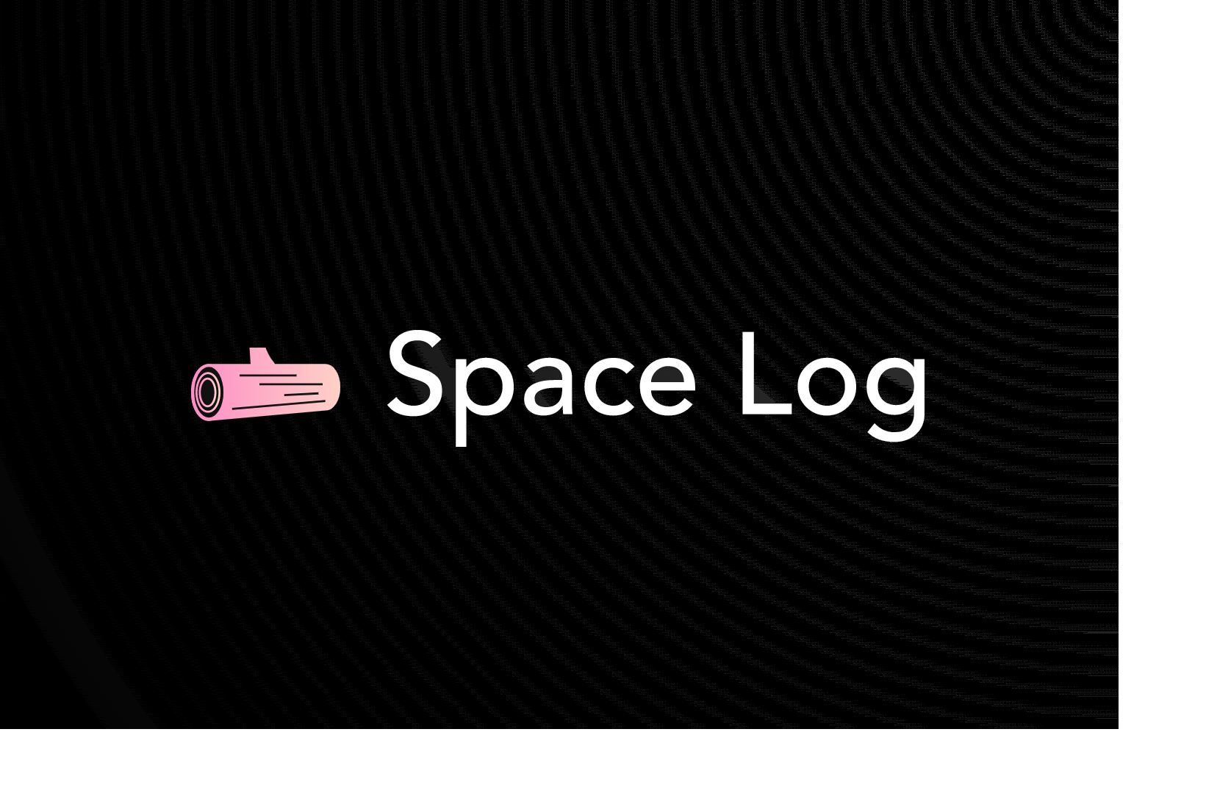
Artemis Generation Challenge
Ravi Nagi, Crystal Nguyen, Adrian Nip, and Abdullah Masood
Notes:
NASA spends $1.3 billion a year on the operations of the International Space Station. We aim to provide a cost cutting solution that automates logistics and inventorying system that leverages cutting-edge technology and artificial intelligence to optimize inventory management, streamline the supply chain, and improve mission success rates.

Slide 2
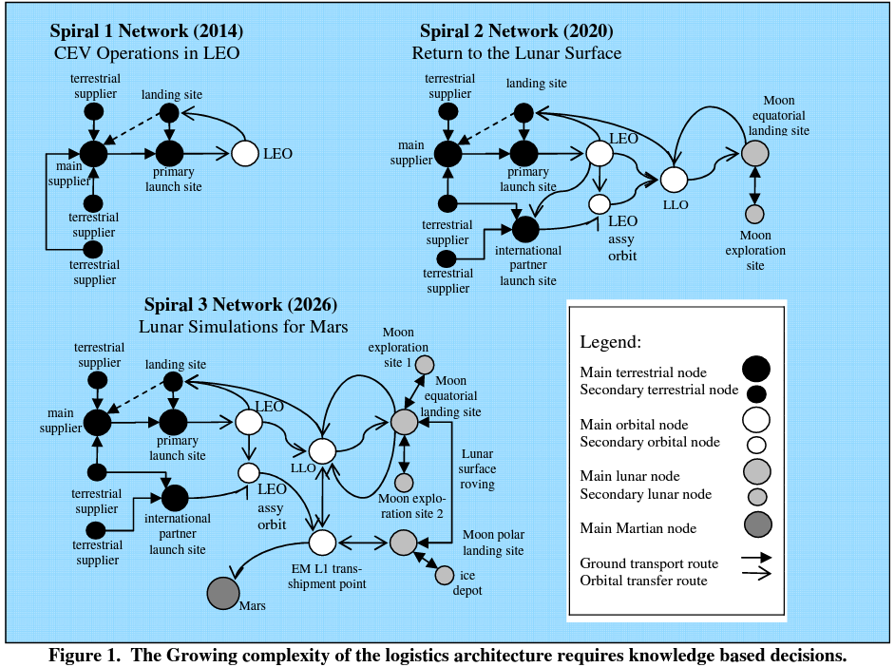

Earth-Space Logistics Network
Current State: Spiral 1 Network
~60-80 labor hours/week spent on optimizing and planning launch cargo manifest
Limited automation capability for logistics management
Future State: Spirals 2 and 3 Networks
Planned increase in supply chain network nodes yields more complexity and uncertainty
Anticipated increase in labor hours dedicated to planning due to logistics scope expansion
Evans & Laufer, “Logistics Lessons Learned in NASA Space Flight Interplanetary Supply Chain Management & Logistics Architectures”, pg 6

Slide 3


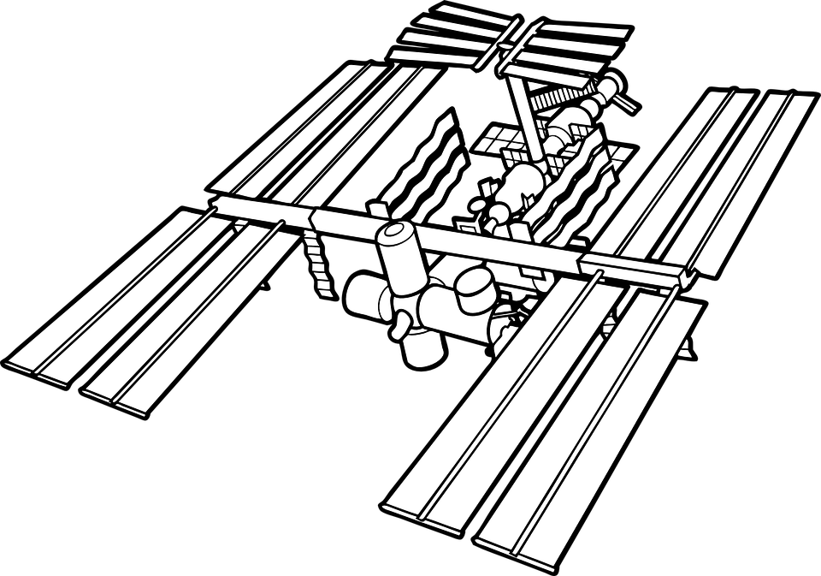

Challenge
Ascent
Science Pack for Launch
Unpack Science
Science Pack for Return
Shuffle Science After Experiments
Descent
Automate & optimize full logistical life cycle of cargo and science from launch, on-orbit operations, and return in order to give rise to efficient and reliable missions
Notes:
Due to limited time and storage capacity, managing inventory levels and supply chain operations in space is crucial for mission success.
Variable launch schedules, equipment failure, and unpredictable environmental conditions also complicate logistics and inventory management in the space industry.
The growing and evolving space industry requires innovative solutions to optimize logistics and inventory processes for efficient and reliable space missions.

Slide 4
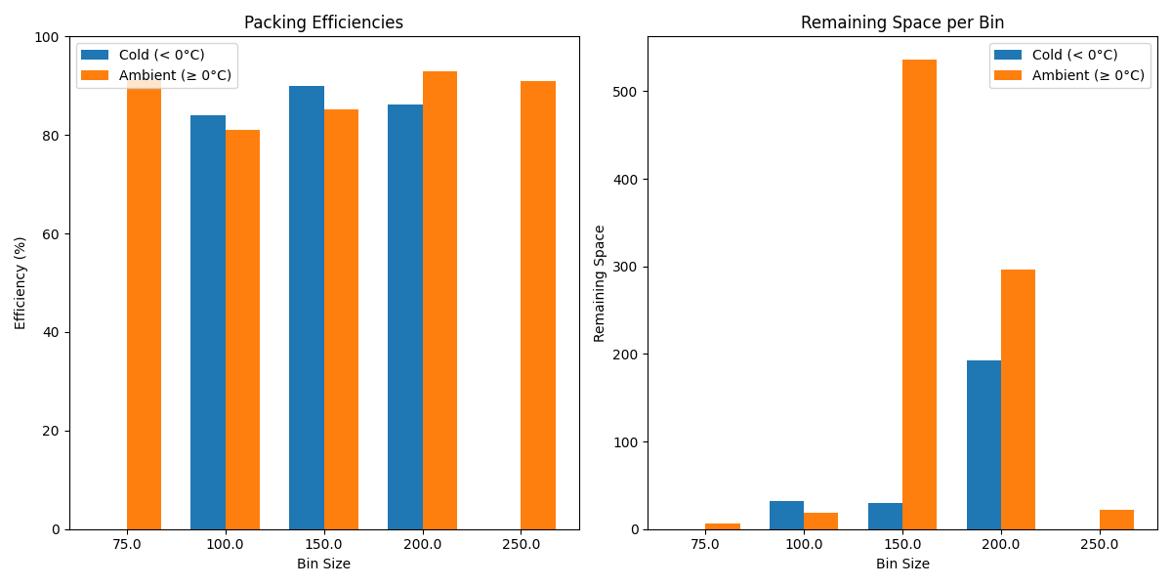
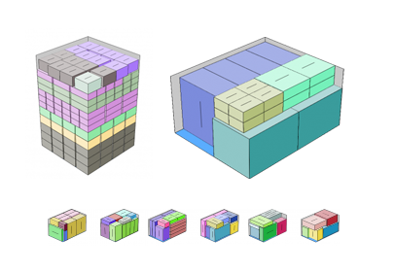
The Space Log Solution: Overview
Software to automate the full logistical life cycle of cargo and science from launch, on-orbit operations, and to return
Employs Machine Learning to sort cargo and science to different hardware locations
Uses bin packing algorithm to optimally pack the cargo and science into the hardware

Slide 5
The Space Log Solution: Inputs and Outputs
Inputs
Cargo and science that goes into the hardware
Ambient
Priority
Mass
Volume
Time and Temperature Sensitive Cargo
Priority
Mass
Volume
Temperature
Inputs
Hardware
Ambient
Volume
Location
Time and Temperature Sensitive Cargo
Volume
Temperature Range
Location
Outputs
Which Hardware
Location of Hardware

Slide 6
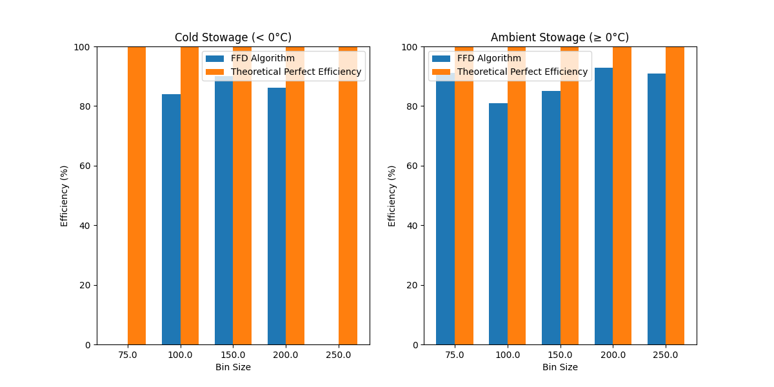
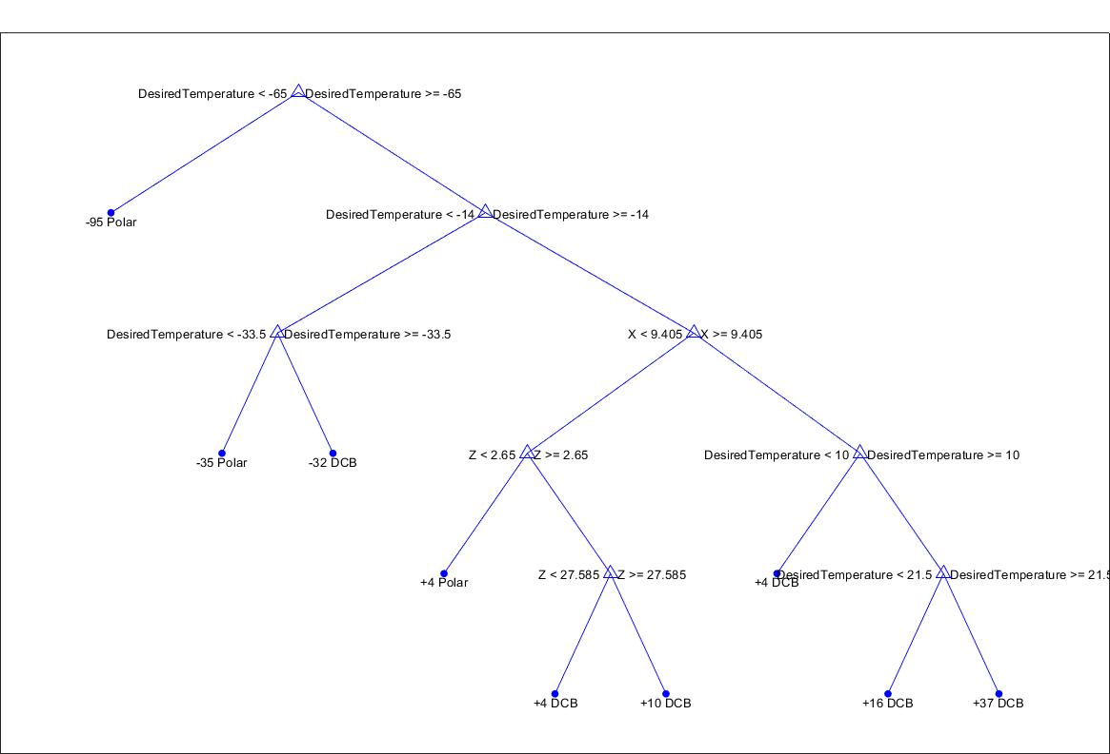
The Space Log Solution: How It Works
Goal: Improves the process of loading cargo for space by automating configuration and inventory planning
Constraints: Priority, mass dimensions, volume, temperature, and orientation
Algorithms: First Fit Decreasing (FFD) and Decision Tree
Applied to optimize the usage of volumes on space stations and future space vehicle applications, specifically addressing the problem of deciding where the science will be stowed based on temperature and dimensions

Slide 7
The Space Log Solution: Pros & Cons
Pros
Reduces labor hours spent on manual manifest development
Minimizes supply chain waste
Decreases opportunity cost and affords time and effort to other initiatives
Cons
Requires significant upfront investment in time for training
Disrupts existing organizational infrastructure (e.g. processes, procedures, roles/responsibilities)
Notes:
Pros:
Saves approx. $455,000 per year per launch in planning labor alone and affords time to create value and cut waste in other areas
Targets supply chain waste (main areas across industries = overproduction, inventory, motion, defects, over-processing, waiting, and transport)
Reduces risk of mistakes by removing human element in planning. Mistakes will have compounded effects
Cons:
Requires a lot of investment in training people (which means additional labor hours spent) and algorithm (which means rollout may cause disruption)
Will cause disruption across workforce as with any tech/system implementation

Slide 8
Future Actions
Train Machine Learning model with more data
Explore other algorithm types (e.g. Best Fit Decreasing, Next Fit Decreasing) to streaming the sorting and packing process
Consider other constraints such as orientation, shape complexity, and real-time adjustments based on changes in cargo requirements
Design standardized database system
Design architecture of database to fit the full life cycle of a cargo/science
Create flight manifest that includes location and packing of hardware using Sort and Packing algorithm (Space Log algorithm)
Update existing inventory management system using current technology
Accurately track inventory using RFID infrastructure (e.g. REALM)
Notes:
10/10

